Slide 1

CS 151
Advanced C++ Programming
Module 16 – Binary Search Trees
Chris Merrill
Computer Science Dept.
cmerrill@miracosta.edu

Slide 2

Agenda
Binary Trees
Binary Search Trees
Lab 16
Review of Final Exam

Slide 3
Topics
19.1 Definition and Application of Binary Trees
19.2 Binary Search Tree Operations
--- Using a Binary Tree as the Underlying Data Structure of a Set
19.3 Template Considerations for Binary
Search Trees

Slide 4
Definition and Application of Binary Trees
Binary tree: a nonlinear data structure in which each node may point to 0, 1, or two other nodes.
The nodes which a node
N points to are the
(left or right)
children
of N.
root
nullptr
nullptr
nullptr
nullptr
nullptr
nullptr

Slide 5
Terminology
If a node N is a child of another node P, then P is called the parent of N.
A node that has no children is called a leaf node.
In every binary tree there is a unique node with no parent. This is the root of the tree.
Every node other than the root of the tree has exactly one parent.

Slide 6
Binary Tree Terminology
Root pointer : like a “head” pointer for a linked list, it points to the root node of the binary tree.
Root node: the node with no parent. Similar to the head of a linked list.
root
nullptr
nullptr
nullptr
nullptr
nullptr
nullptr

Slide 7
Binary Tree Terminology
Leaf nodes: nodes that have no children.
The nodes containing 28 and 37 are leaf nodes.
root
63
85
54
28
nullptr
37
nullptr
nullptr
nullptr
nullptr
nullptr

Slide 8
Binary Tree Terminology
Child nodes, children:
The children of the node containing 63 are the nodes containing 85 and 54.
root
63
85
54
28
nullptr
37
nullptr
nullptr
nullptr
nullptr
nullptr

Slide 9
Binary Tree Terminology
root
The parent of the node containing 28 is the node with 85.
63
85
54
28
nullptr
37
nullptr
nullptr
nullptr
nullptr
nullptr

Slide 10
Binary Tree Terminology
A subtree of a binary tree is a part of the tree from a node N down to the leaf nodes.
Such a subtree is said to be rooted at N, and N is called the root of the subtree.

Slide 11
Subtrees of Binary Trees
A subtree of a binary tree is itself a binary tree.
A nonempty binary tree consists of a root node, with the rest of its nodes forming two subtrees, called the left and right subtree.
root
63
85
54
28
nullptr
37
nullptr
nullptr
nullptr
nullptr
nullptr

Slide 12
Subtrees of Binary Trees
The node containing 63 is the root.
The nodes containing 85 and 28 form the left subtree.
The nodes containing 54 and 37 form the right subtree.
root
63
85
54
28
nullptr
37
nullptr
nullptr
nullptr
nullptr
nullptr

Slide 13
Uses of Binary Trees
Binary search tree: a binary tree whose data is organized to simplify searches.
Left subtree at each node contains data values less than the data in the node.
Right subtree at each node contains values greater than the data in the node.
root
31
19
59
7
nullptr
43
nullptr
nullptr
nullptr
nullptr
nullptr

Slide 14
Uses of Binary Search Trees
Can you see how a binary search tree can be used to perform searches?
Binary searches must be performed on sorted data sets.
Compare key to the root node data element (corresponding roughly to the data at the midpoint of an array).
If the search key comes before the root node data, then eliminate all data in the right subtree and begin searching the left subtree.
Otherwise eliminate the left subtree and search the right subtree.

Slide 15
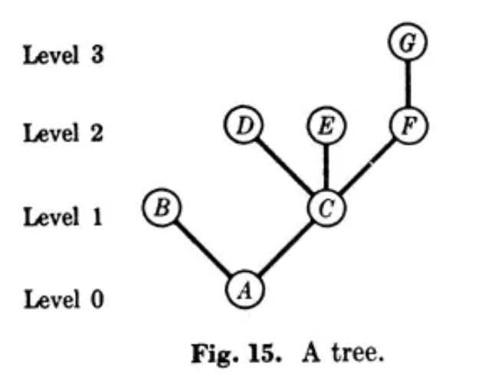
Why Are Trees Drawn Upside Down?
In The Art of Computer Programming – Algorithms, by Donald Knuth, Chapter 2, "Trees“, the following appeared:

Slide 16
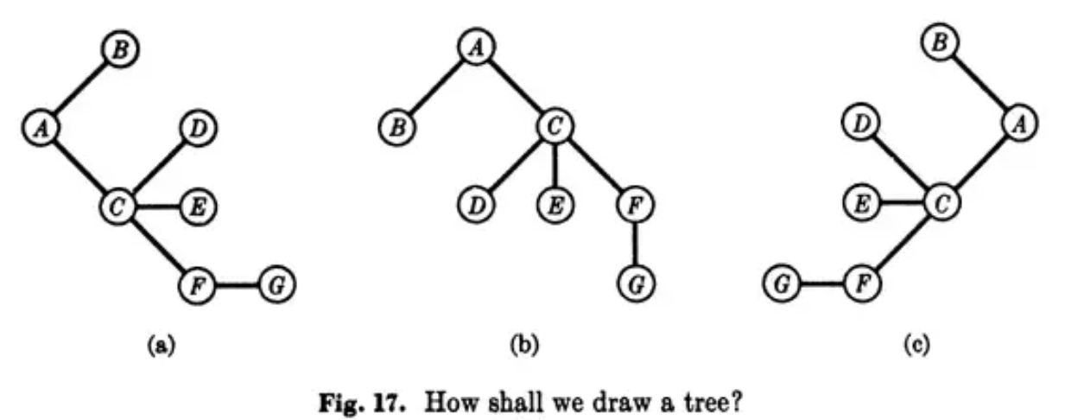
Why Are Trees Drawn Upside Down?
This seems more natural, as it is the way that trees normally grow, with the root at the bottom and fulling at the top.
However, after studying how most trees were drawn in the computer literature and textbooks of the time, he found that almost 80% of the trees were being upside down!
Version (b) was adopted and has become the standard ever since.

Slide 17
Binary Search Tree Operations
Create a binary search tree:
Insert a node into a binary tree – put node into tree in its correct position to maintain order.
Find a node in a binary tree – locate a node with particular data value.
Delete a node from a binary tree – remove a node and adjust links to preserve the binary tree and the order.

Slide 18
Binary Search Tree Node
A node in a binary tree is like a node in a doubly linked list (two node pointer fields):
class TreeNode {
int value ;
TreeNode *left ;
TreeNode *right ;
} ;
Define the nodes as structure objects.

Slide 19
TreeNode Constructor
A constructor aids in the creation of nodes
TreeNode(int value1,
TreeNode *left1 = nullptr,
TreeNode *right1 = nullptr) {
value = value1 ;
left = left1 ;
right = right1 ;
}

Slide 20
Creating a New Node
TreeNode *ptr ;
int num = 23 ;
<ptr> = new TreeNode(num) ;
ptr
23
nullptr
nullptr

Slide 21
BinaryTree Constructor
To construct a binary tree, just create an empty node for the “top” of the tree:
TreeNode root = nullptr ;
Note that the head node is called “root” instead of “head”.

Slide 22
Binary Search Tree Outline
External (public) function prototypes will be included:
void insert(int) ;
void remove(int) ;
void search(int) const ;
void displayInorder() const ;
void displayPreorder() const ;
void displayPostorder() const ;

Slide 23
Binary Search Tree Outline
Recursive (private) function prototypes will be included:
void insert(TreeNode *&, int ) ;
void destroySubtree(TreeNode *} ;
void remove(TreeNode *&, int} ;
void makeDeletion(TreeNode *&) ;
void displayInorder(TreeNode *} const ;
void displayPreorder(TreeNode *) const ;
void displayPostorder(TreeNode *) const ;

Slide 24
Inserting an Item into a Binary Search Tree
Algorithm:
If the tree is empty, replace the empty tree with a new binary tree consisting of the new node as root, with empty left and right subtrees.
If the item is “less than” (comes before) the root node, recursively insert the item in the left subtree.
If the item is “greater than” (comes after) the root node, recursively insert the item into the right subtree

Slide 25
Building a Binary Search Tree
Notes:
In all cases, the root node will be the first node entered into the tree.
Once a node is entered into the tree, it doesn’t move unless it or one of its ancestor nodes is removed.
No node can be entered until its parent node is entered, so new nodes will always be leaf nodes.
This explains the recursive nature of adding nodes into the tree.

Slide 26
Building a Binary Search Tree
root
Let’s build our binary search tree, starting with an empty tree.
nullptr

Slide 27
Building a Binary Search Tree
root
First node to be inserted is the root (top) node 31.
31
nullptr
nullptr

Slide 28
Building a Binary Search Tree
root
31
Next insert 19 (starting to build the left subtree).
19
nullptr
nullptr
nullptr

Slide 29
Building a Binary Search Tree
root
31
Insert 59 (starting to build the right subtree).
19
59
nullptr
nullptr
nullptr
nullptr

Slide 30
Building a Binary Search Tree
root
31
19
59
Insert 43 recursively into the right subtree.
nullptr
nullptr
43
nullptr
nullptr
nullptr

Slide 31
Building a Binary Search Tree
root
31
19
59
Last node to be inserted is 7 recursively into the left subtree.
7
nullptr
43
nullptr
nullptr
nullptr
nullptr
nullptr

Slide 32
Building a Binary Search Tree
Notice that the same binary search tree can be built inserting nodes in the following sequences (row-by-row)
31, 19, 59, 7, 43 5. 31, 59, 19, 7, 43
31, 19, 59, 43, 7 6. 31, 59, 19, 43, 7
31, 59, 19, 7, 43 7. 31, 19, 59, 7, 43
31, 59, 19, 43, 7 8. 31, 19, 59, 43, 7

Slide 33
Building a Binary Search Tree
The same binary search tree also could be built by inserting nodes column-by-column:
31, 19, 7, 59, 43
31, 59, 43, 19, 7

Slide 34
Building a Binary Search Tree
Finally, the same binary search tree also could be built by using semi-random patterns:
31, 19, 59, 43, 7
31, 59, 19, 7, 43
Sequence #1 above was the sequence used to build our original binary search tree in the previous slides.

Slide 35
Inserting an item into a Binary Search Tree
value to insert: 23
Step 1: 23 is less than 31. Recursively insert 23 into the left subtree.
31
19
59
7
nullptr
43
nullptr
nullptr
nullptr
nullptr
nullptr

Slide 36
Inserting an item into a Binary Search Tree
value to insert: 23
Step 2: 23 is greater than 19. Recursively insert 23 into the right subtree.
root
31
19
59
7
nullptr
43
nullptr
nullptr
nullptr
nullptr
nullptr

Slide 37
Inserting an item into a Binary Search Tree
value to insert: 23
root
31
19
59
7
nullptr
43
nullptr
nullptr
nullptr
nullptr
nullptr
Step 3: The right subtree is empty, so insert 23 here.

Slide 38
Inserting an item into a Binary Search Tree
value to insert: 23
root
31
Resulting tree after 23 is entered.
Where would nodes be located if inserting 10, 45, 68, and 99?
19
59
7
23
43
nullptr
nullptr
nullptr
nullptr
nullptr
nullptr
nullptr

Slide 39
Insertion Detail - External
Create a public version of the insert function available outside of the class:
void insert(int num) {
insert(root, num) ;
}
This version starts at the top of the binary search tree, then calls the private recursive version.

Slide 40
Insertion Detail
allow updates
The recursive private version of the insert function
void insert (TreeNode * &tree , int num) {
// If (sub)tree is empty, make the root
if (! tree) {
tree = new TreeNode (num) ;
return ;
}

Slide 41
Insertion Detail (continued)
// If num is already in tree, return
if (tree->value == num)
return ;
// The tree is not empty, so insert new
// node into the left or right subtree
if (num < tree->value)
insert(tree->left, num);
else
insert(tree->right, num);
}

Slide 42
Deleting a Leaf Node
If node to be deleted is a leaf node, replace the parent node’s pointer to it with a nullptr, then delete the node.
19
19
7
nullptr
nullptr
nullptr
nullptr
nullptr
Deleting node with 7 – after deletion
Deleting node with 7 – before deletion

Slide 43
Deleting a Node with One Child
If the node to be deleted has one child node, adjust the pointers so that parent of the node to be deleted points to child of the node to be deleted, then delete the node.

Slide 44
Deleting a Node with One Child
root
root
31
31
19
59
7
59
7
nullptr
43
nullptr
nullptr
nullptr
43
nullptr
nullptr
nullptr
nullptr
nullptr
nullptr
nullptr
Deleting node containing 19 – before deletion
Deleting node containing 19 – after deletion

Slide 45
Deleting a Node with Two Children
If node to be deleted has left and right children,
‘Promote’ one child to replace the deleted node
Locate correct position for the other child in subtree of promoted child
Convention in the text: “attach" the right subtree to its parent, then position the left subtree at the appropriate point in the right subtree.
Care must be taken when re-attaching the left subtree to maintain the search property of a binary search tree.

Slide 46
Deleting a Node with Two Children
root
root
59
31
43
nullptr
19
59
19
nullptr
7
nullptr
43
nullptr
7
nullptr
nullptr
nullptr
nullptr
nullptr
nullptr
nullptr
Deleting node containing 31 – before deletion
Deleting node containing 31 – after deletion

Slide 47
Three Techniques to Traverse a Binary Tree
Inorder: a) traverse left subtree of node
b) process data in node
c) traverse right subtree of node
Preorder: a) process data in node
b) traverse left subtree of node
c) traverse right subtree of node
Postorder: a) traverse left subtree of node
b) traverse right subtree of node
c) process data in node

Slide 48
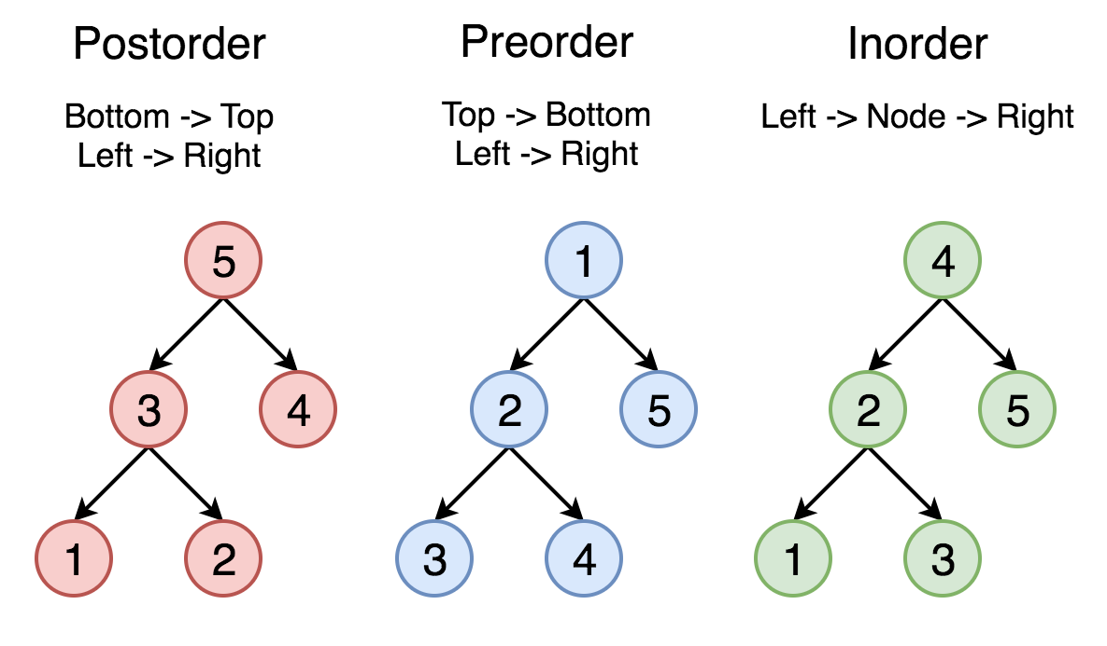

Slide 49
Traversing a Binary Tree
root
TRAVERSAL PROCESS | NODES VISITED IN THIS ORDER
Inorder | 7, 19, 31, 43, 59
Preorder | 31, 19, 7, 59, 43
Postorder | 7, 19, 43, 59, 31
31
19
59
7
nullptr
43
nullptr
nullptr
nullptr
nullptr
nullptr

Slide 50
Observations
In the inorder traversal process, the data values are processed in ascending value order.
In fact, this is true no matter the order in which the nodes are entered!
An inorder traversal will process all nodes “less” than the current node, then the current node, then all nodes “greater” than the current node.

Slide 51
Searching in a Binary Tree
Start at root node.
Examine the node’s data:
If it’s the desired value, done.
If desired data < node data, repeat with left subtree.
else, if desired data > node data, repeat with right subtree
Continue until desired value is found or nullptr is reached.
root
31
19
59
7
nullptr
43
nullptr
nullptr
nullptr
nullptr
nullptr

Slide 52
Searching Implementation Detail
bool search(int num) const {
TreeNode *tree = root ;
while (tree) {
if (tree->value == num)
return true ;
if (num < tree->value}
tree = tree->left ;
else
tree = tree->right ;
}
return false ;
}
No recursion required

Slide 53
Template Considerations for Binary Search Trees
A binary tree can be implemented as a template, allowing flexibility in determining the type of data stored.
The implementation must support the following relational operators:
>, <, and ==
to allow for the comparison of nodes.

Slide 54
Exercise #1
Using a binary search tree of integers, map the structure of a tree when the nodes are entered in the following order:
5, 8, 3, 12, and 9
Determine the order the nodes would be processed when traversing in preorder, inorder, and postorder.

Slide 55
Building The Tree
root
Make an empty tree by creating root

Slide 56
Building The Tree
root
5
Add
5

Slide 57
Building The Tree
root
5
8
Add
8

Slide 58
Building The Tree
root
5
3
8
Add
3

Slide 59
Building The Tree
root
5
3
8
Add
12
12

Slide 60
Building The Tree
root
5
3
8
Add
9
12
9

Slide 61
Preorder Traversal
root
Start at root
Left (done)
Up
Right (no left)
Right
Left (done)
Up (done)
Up (done)
Up (done)
5
3
8
12
5 3 8 12 9
9

Slide 62
Inorder Traversal
root
Start at root
Left (done)
Up
Right (no left)
Right
Left (done)
Up (done)
Up (done)
Up (done)
5
3
8
12
3 5 8 9 12
9

Slide 63
Postorder Traversal
root
Start at root
Left (done)
Up
Right (no left)
Right
Left (done)
Up (done)
Up (done)
Up (done)
5
3
8
12
3 9 12 8 5
9

Slide 64
Binary Search Tree
Demonstrate a binary search tree using characters and doubles.
(Binary Tree)

Slide 65
Tree from part 1 f, 7, L, A, x, 3, n, 4, A, y
root
f
7
x
3
L
n
y
4
A

Slide 66
Redefining a Set
In the last Module, we used a linked list as the underlying structure of a set. However, a binary tree might make more sense for its superior performance in searching and sorting.
(Set Using Binary Tree)

Slide 67
Efficiency of Binary Search Trees
A binary search tree that is as short as possible (smallest height) can be processed most efficiently.
A “short” tree is one where all paths from root to a leaf differ by at most one node.
When this is so, the search algorithm is as efficient as a binary search on a sorted array.
Its worst-case running time is O(log₂ n), where n is the number of nodes in the tree.

Slide 68
Efficiency of Binary Search Trees
No. of Elements | Optimum Levels
1 | 1
3 | 2
6 | 3
60 | 6
250 | 8
1,000 | 10
30,000 | 15
1,000,000 | 20
Consider the following chart:
As the number of elements in a flat binary search tree increases, the number of levels in that tree increases much slower.

Slide 69
Efficiency of Binary Search Trees
When compared to a sorted linked list, to find the location of an element is dramatically better in a binary tree as the number of elements increases.
When compared to a sorted vector, to insert or delete an element is dramatically better in a binary tree.
One controlling factor is the overhead required to keep the binary tree flat or near-flat.

Slide 70
Efficiency of Binary Search Trees
As a tree becomes taller and thinner, this efficiency falls off.
In the worst case, it is the same as searching a linked list with the same number of nodes O(n),
Maintaining a tree so that it remains short and flat as nodes are added, is known as balancing the tree, and a tree maintained in this manner is called a balanced tree.

Slide 71
How Do Trees Become Unbalanced?
Notice that the first element entered in a tree becomes its root.
What happens if we enter elements in ascending order (say “A”, “B”, “C”, “D”, “E”. “F”, and “G”)?
How would we rebalance this tree?
What happens if we enter elements in descending order?

Slide 72
Unbalanced
A G
\ /
B F
\ /
C E
\ /
D D
\ /
E C
\ /
F B
\ /
G A
Each tree has 7 levels
(height = 7)
ascending
order
descending
order
Average: 4

Slide 73
A Balanced Tree
D
/ \
B F
/ \ / \
A C E G
Tree has only 3 levels
(height = 2)
Average: 2.42

Slide 74

How To Balance A Tree
Suppose we have 7 elements that we
want to enter in a binary tree.
How can we determine what a balanced tree would look like?
We can determine that a tree with 7 nodes does not need more than 3 levels:
1 + 2 + 4 = 2^{n} - 1 = 7

Slide 75
Determining Structure Using Inorder
A balanced binary tree with 7 nodes
D
/ \
B F
/ \ / \
A C E G
4th
2nd
6th
1st
7th
3rd
5th

Slide 76
How To Enter A Balanced Tree
One algorithm to enter a balanced tree is recursive
Order the list that holds the tree.
Find the middle element and make that the top node of the tree. Enter that node first.
Find the middle node in the first half of the tree and make that the next left node. Enter 2nd …
Find the middle node in the 2nd half of the tree and make that the next right node.

Slide 77
Recursive Balancing Using Binary Division
A B C D E F G
Order to Enter: D B A C F E G
1st
2nd
5th
3rd
4th
6th
7th

Slide 78
How To Balance A Tree
Notice that entering elements level-by-level also will work:
D
Level 1: D / \
Level 2: BF B F
Level 3: ACEG / \ / \
A C E G

Slide 79
Level-by-Level Balancing Using Binary Division
A B C D E F G
Order to Enter: D B F A C E G
1st
2nd
3rd
4th
5th
6th
7th

Slide 80
Exercise #2
Using the binary tree of integers from Exercise 1, create a balanced tree with nodes
5, 8, 3, 12, and 9

Slide 81
Answer
First list the numbers in order:
3 5 8 9 12
Level 1: 8 – the middle of the list
Level 2: 3 (left of 8), 9 (right of 8)
Level 3: 5 (right of 3), 12 (right of 9)

Slide 82
Building The Tree Are there other structures with the same data values which also are balanced?
root
8
3
9
5
12

Slide 83
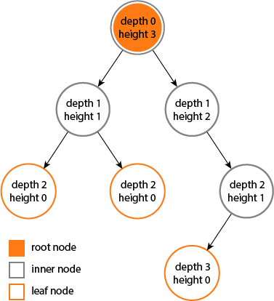
Height And Depth of a Tree
The height of a node is the maximum number of edges from that node to a leaf node.
The depth of a node is the maximum number of edges from the node to the root of its tree

Slide 84
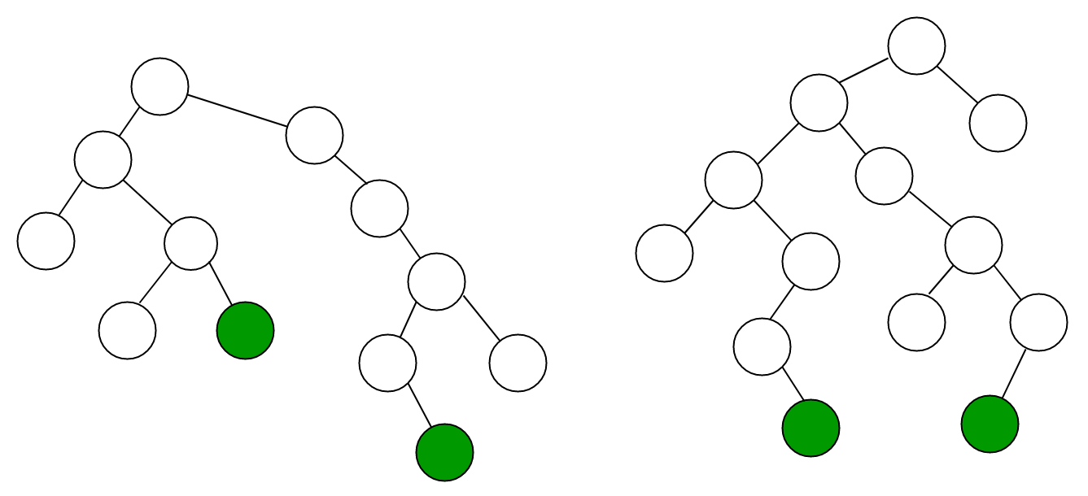
Diameter or Width of a Tree
The diameter or width of a tree is the number of nodes on the longest path between two leaves in the tree (same as the height of a tree with maximum number of nodes).
Two trees with
diameters of 8,
one through the
root, the other not
through the root.

Slide 85
Assignments for Module 16
Read textbook chapter 19 (Binary Trees)
Complete Lab 16
Complete old homework and lab assignments
Complete final or research projects
Prepare for final exam

